Slide 1
OMS Results
Preparing for regional visit
Aman Majid - June 2022

Slide 2
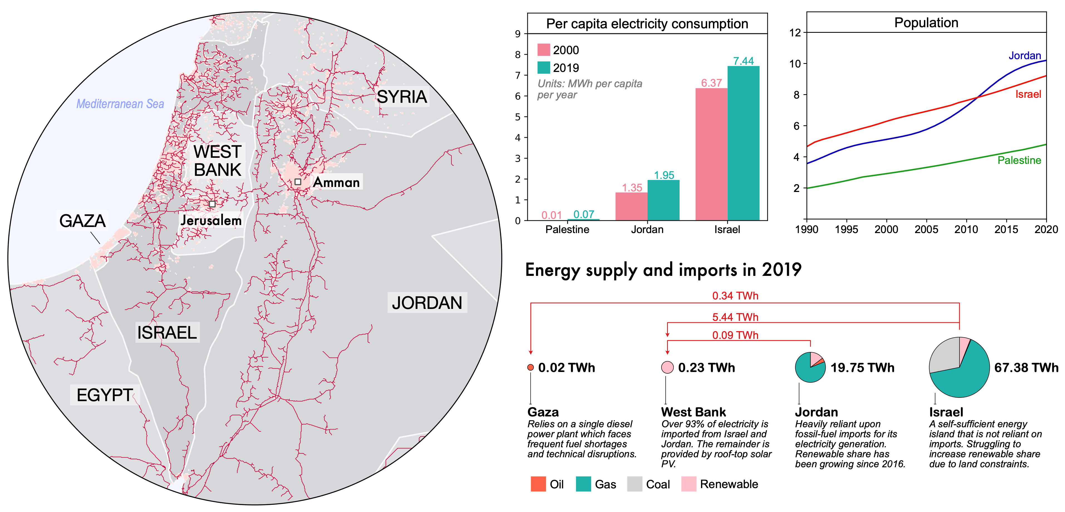
Figure: Infographic describing the current electricity system in Israel, Palestine, and Jordan.

Slide 3
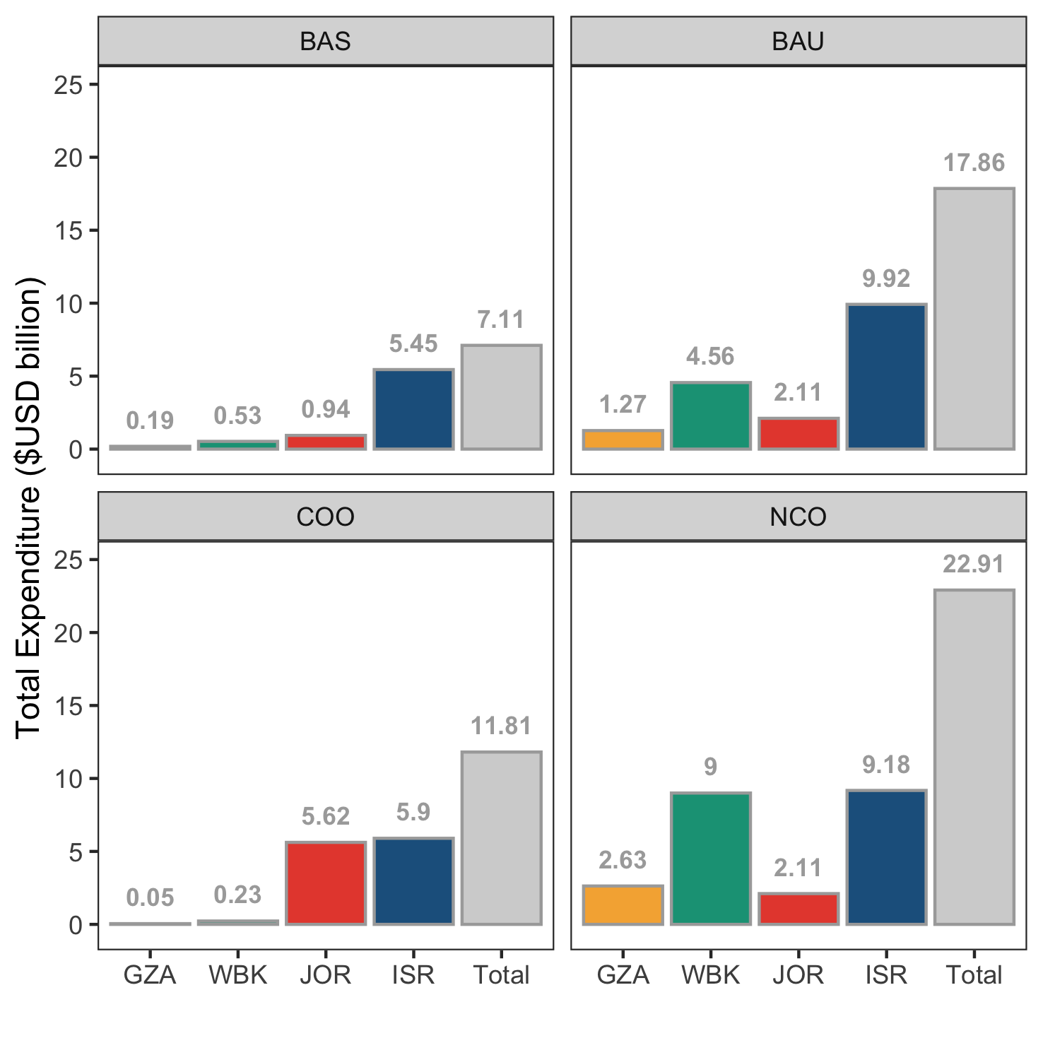
Figure: Total of capital and operational expenditure ($USD billion) for each region under the four scenarios evaluated. The grey bar shows the sum of expenditures across all four regions for a given scenario.

Slide 4
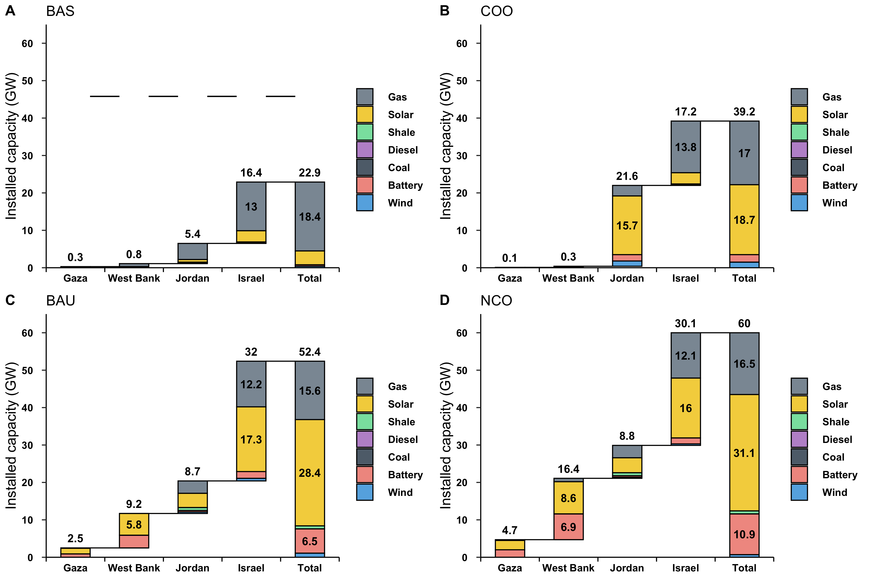
Figure: Installed capacities in 2030 (GW) under the four scenarios evaluated. Capacities of each technology are shown for each region, but are also totalled for the whole system.

Slide 5
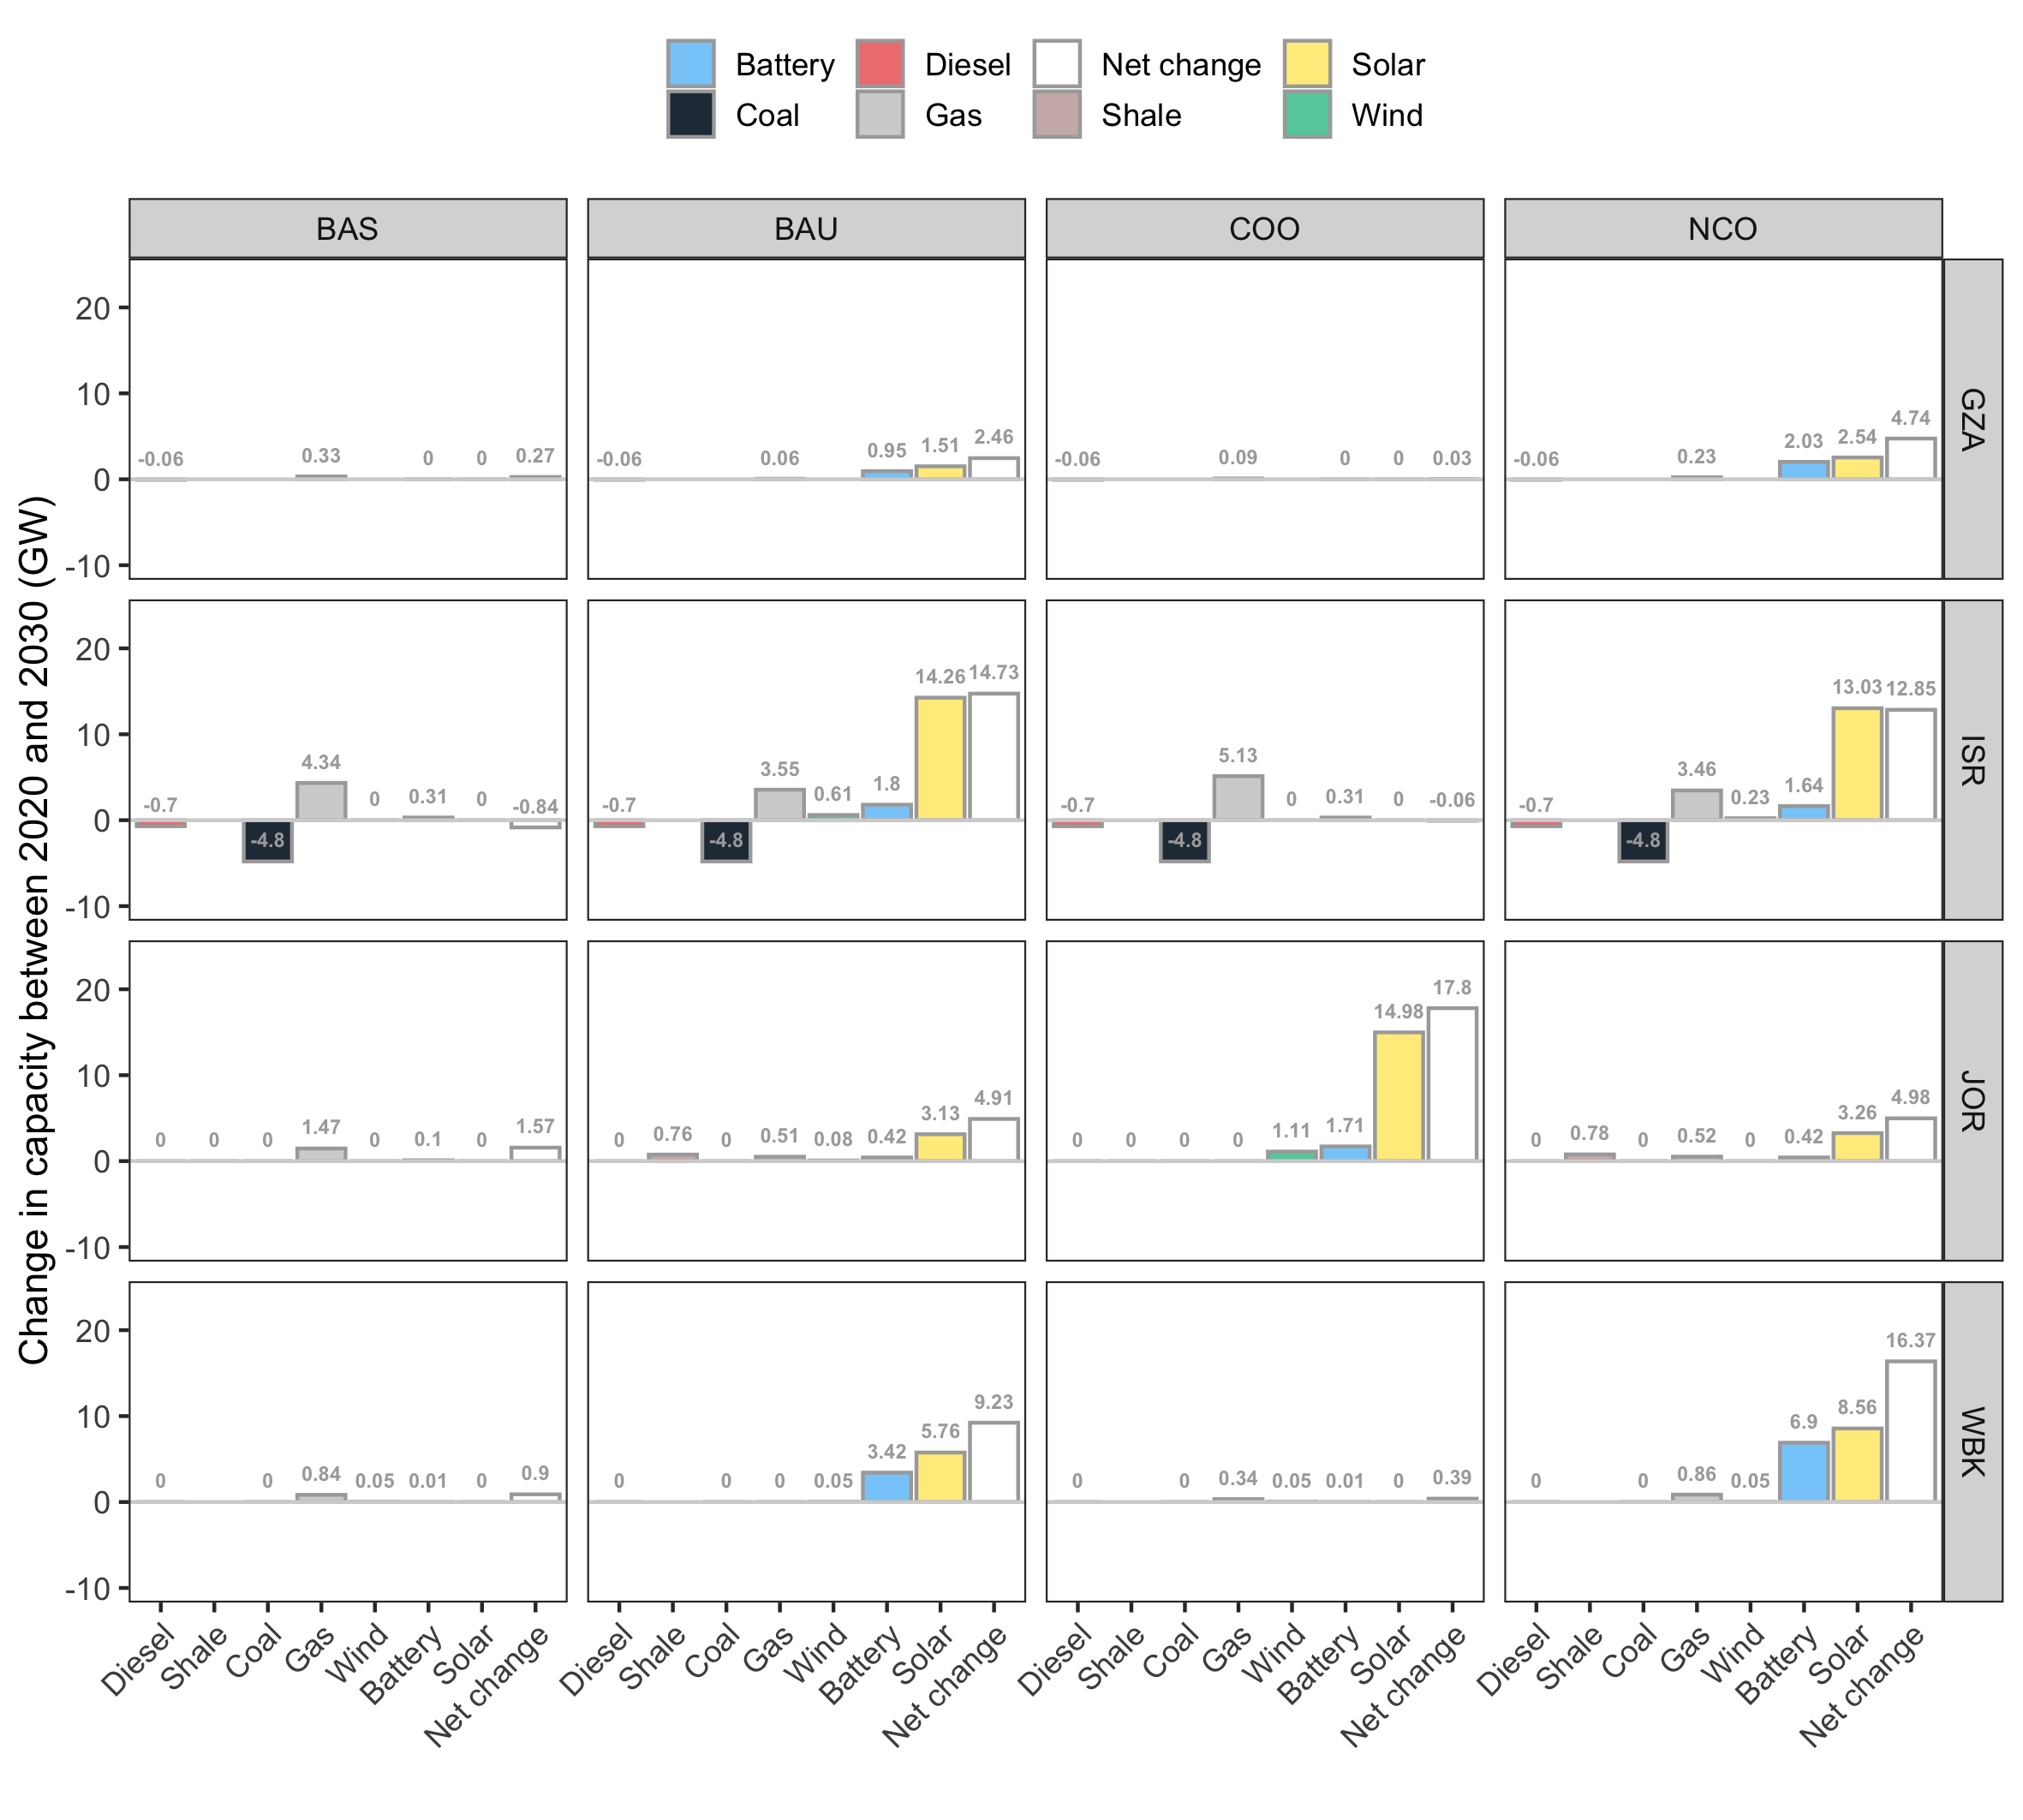
Figure: Net capacity change to 2030 (relative to 2020) by region and scenario. All capacities are shown in GW.

Slide 6
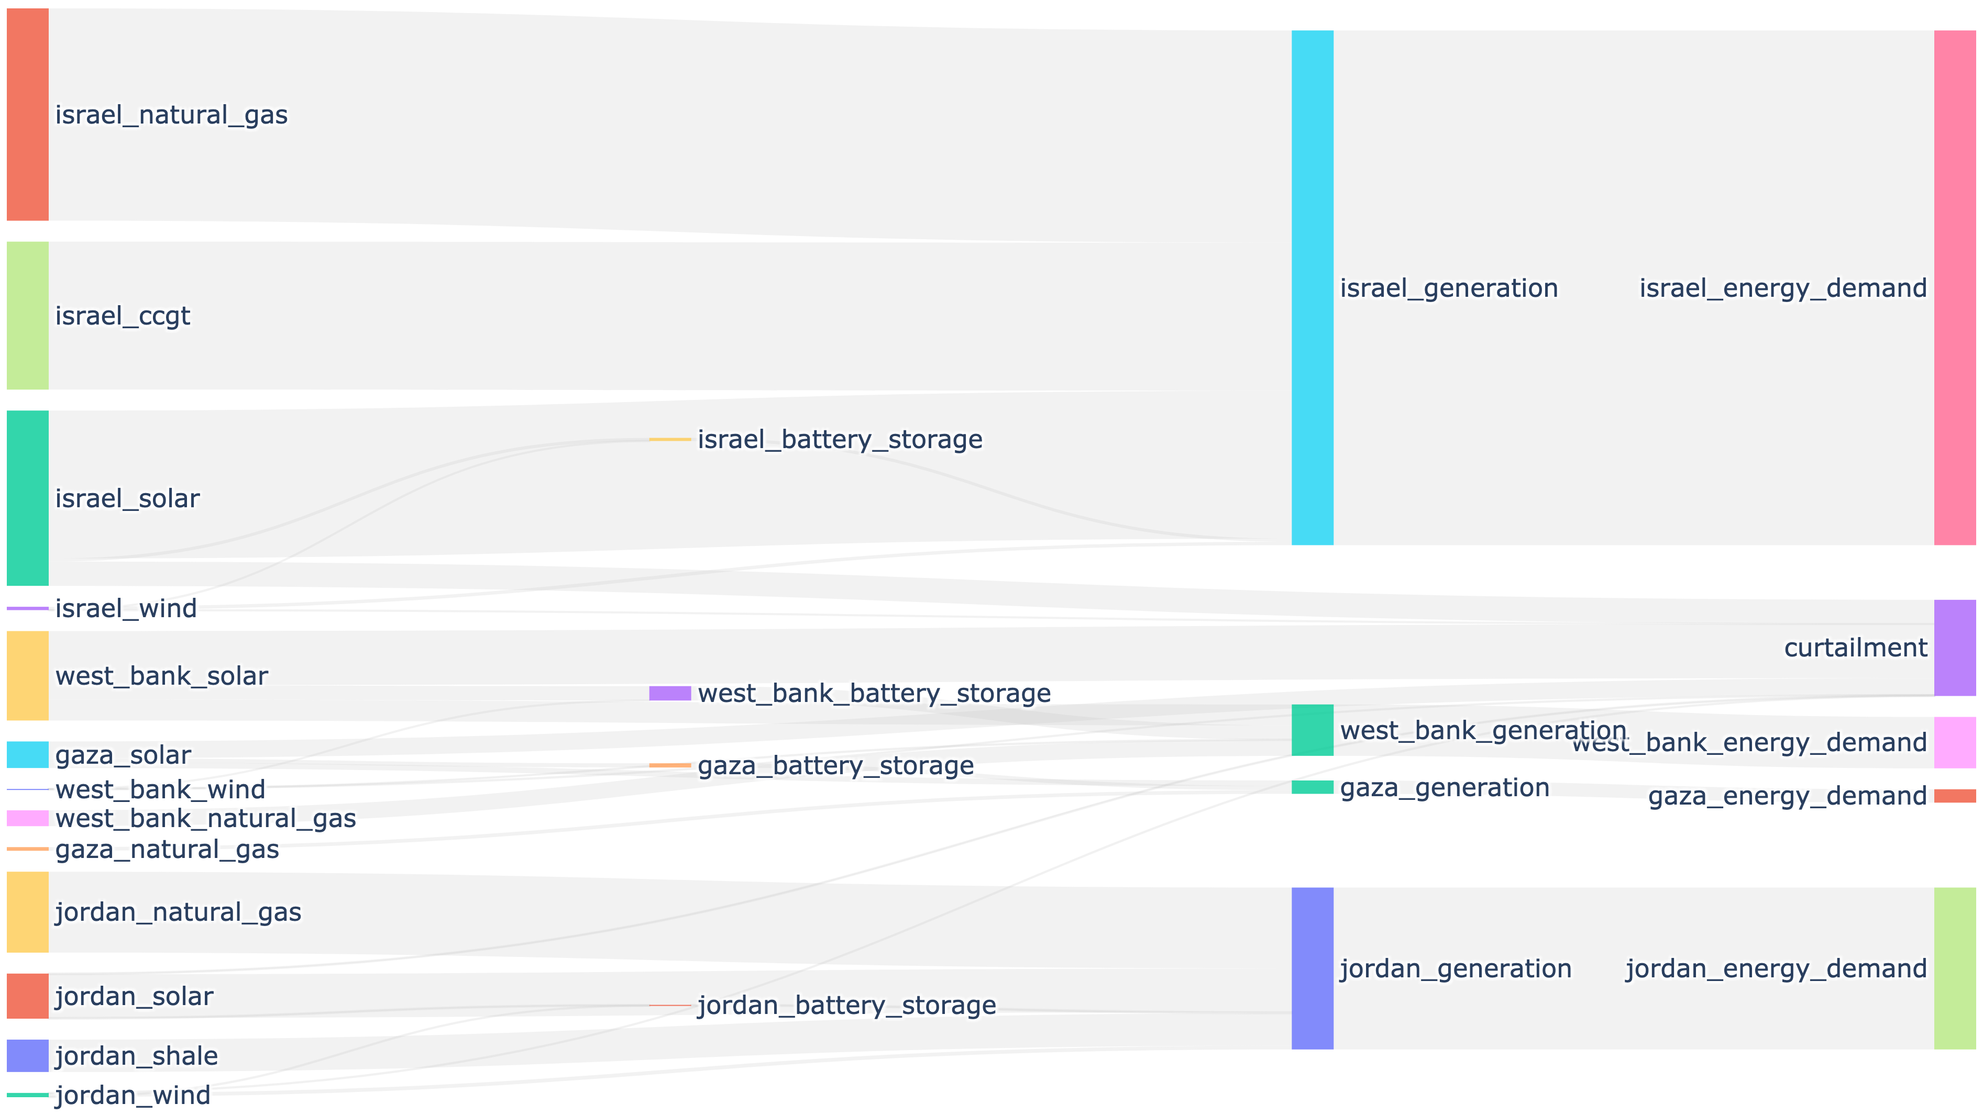

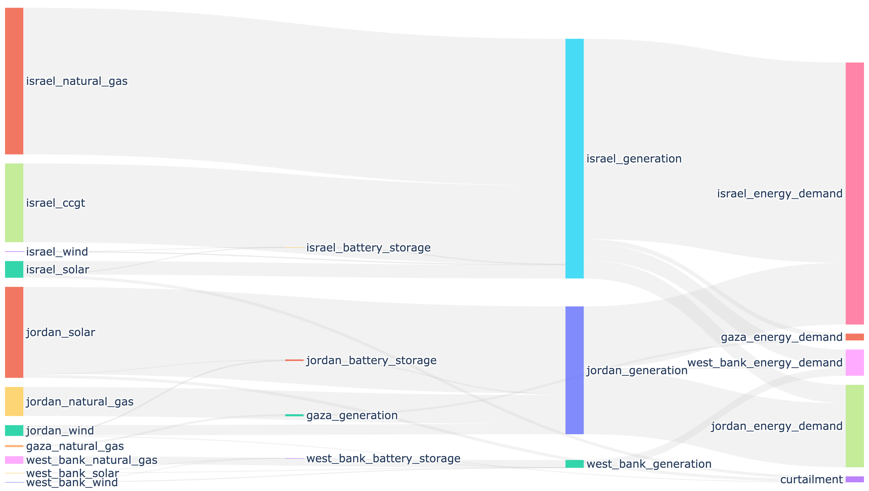

NCO
COO
Figure: Sankey diagrams illustrating the interregional flows of electricity under the NCO and COO scenarios.

Slide 7
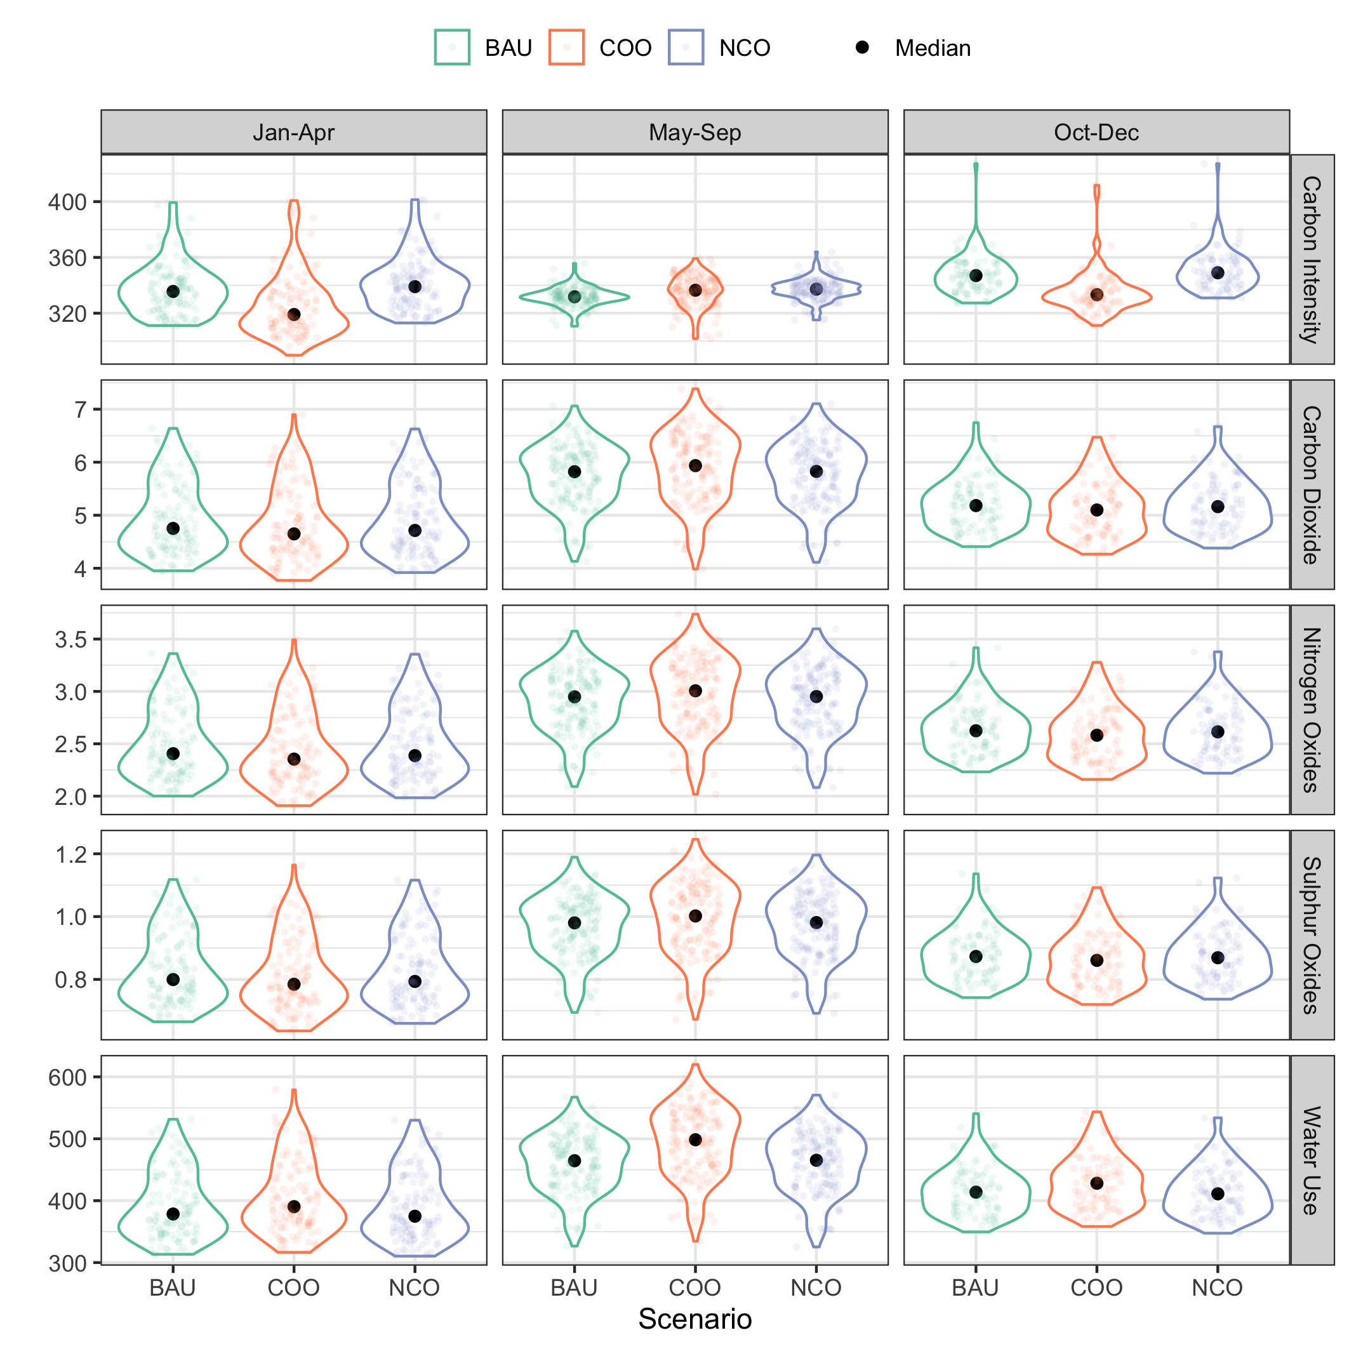
Figure: Emissions variables in 2030 under BAU, COO and NCO scenarios. The panels show carbon intensity (g/kWh), carbon dioxide (kg/day), nitrogen oxides (kg/day), sulphur oxides (kg/day), and water use (L/day) over three periods: 1) January to April; 2) May to September; and 3) October and December. Each plot shows a violin plot distribution, as well as the median in the data (black point).

Slide 8
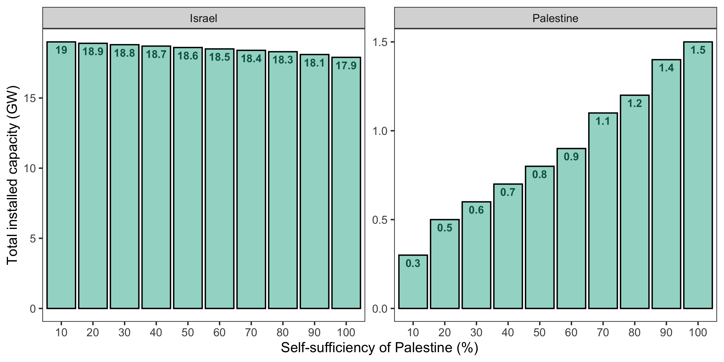
Figure: The influence of Palestinian self-sufficiency targets on the total capacity requirements under the COO scenario. Note that the capacities in Jordan do not change and hence are not shown here.

Slide 9
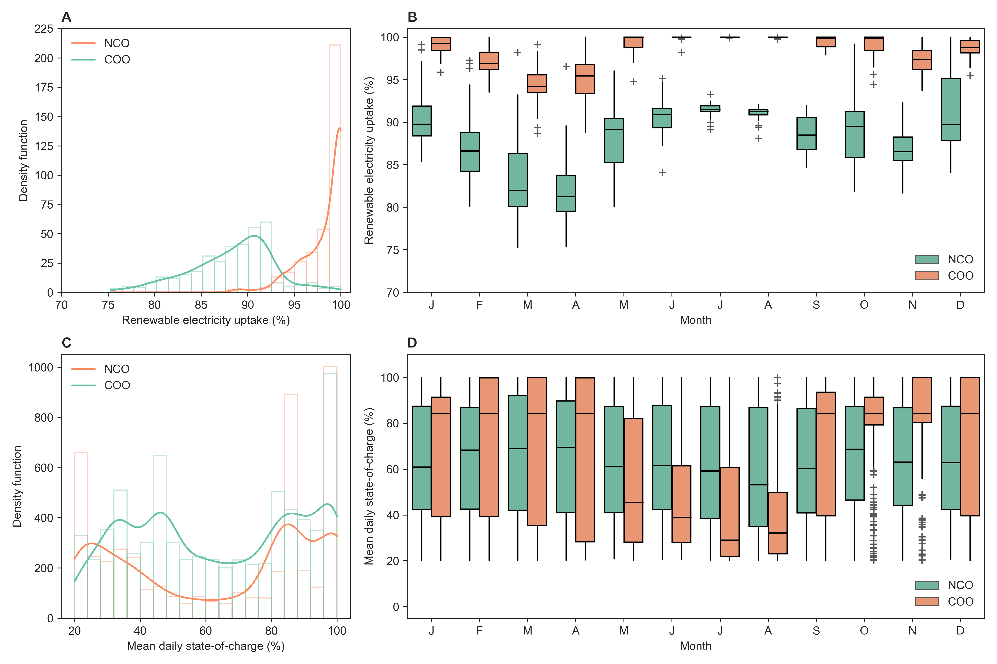
Figure: Temporal analysis of renewable energy uptake, battery state-of-charge, and conventional generation under the COO and NCO scenarios.

